Slide 1
Phase 1
Communication System Group 1

Slide 2
Top 10 Requirements for Communication System
Users can have asynchronous/synchronous messaging between 2 or more users.
Users can create channels/chat rooms to segment conversations
IT and users login with a username and password
The program connects to a network via a Server and Client
The program has built in Java and GUI interface
IT have the ability to hide channels and block user accounts, but log is kept of them.
Logs are created and updated for every channel of communication
Users have the ability to delete/modify their messages
Users have the ability to directly reply to specific messages in a chat
IT and users have the ability to search in the list of current users

Slide 3
Class Candidates
User/Employees
IT User
Channel/Chat
Server
Client
Log

Slide 4
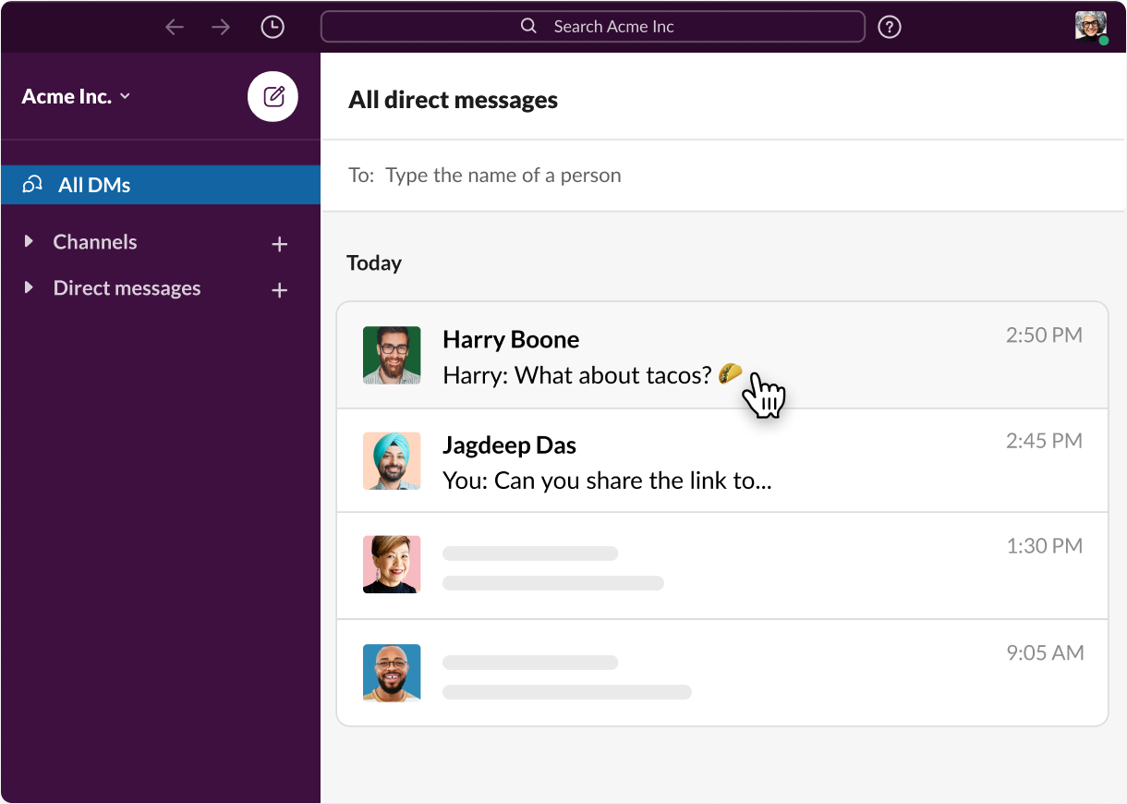
One of the use cases
Use Case ID: createMessage1
Use Case Name: Messaging another user
Relevant Requirements: User messages another User
Primary Actor: User
Preconditions: Client is connected to server and is logged in
Postcondition: Both Users are able to see messages.
Basic Flow:
User A searches up User B using some unique identifier like an email or name.
User A types in messages and sends them to User B.
User A’s message should be shown to only User A and User B.
Alternate Flow:
User A already has a chat history with User B.
User A can directly select that message interface without explicitly searching User B’s information
User A and B begin messaging.
Exceptions:
User A is unable to find User B due to User B’s information being corrupted in the database.
Related Use Cases:
User can create a group chat and message multiple users

Slide 5
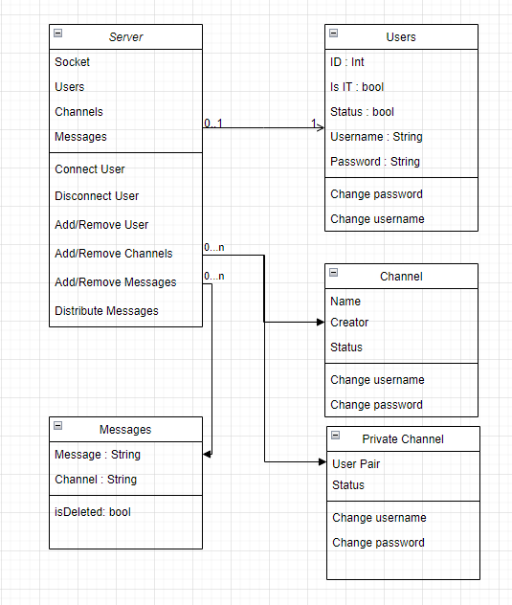
Server Class Diagram

Slide 6
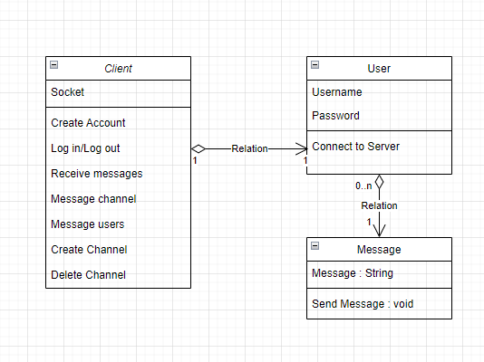
Client Class Diagram

Slide 7
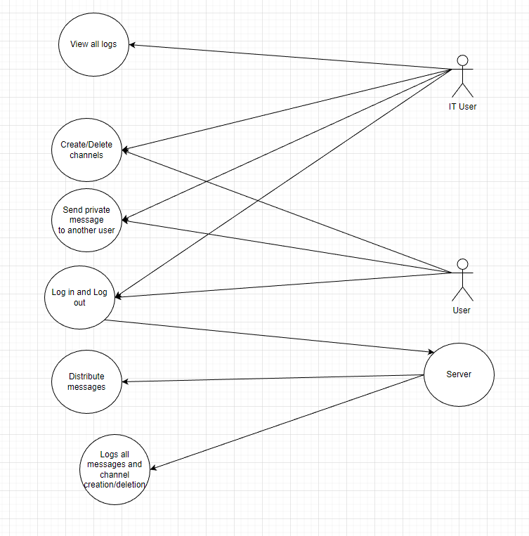
Use Cases

